Slide 1
In this power point we will discuss the
probability of an employee to excessively absent (be absent for more than 3 hours), based on different features like:
.) Age
.) Poisoning
.) Transportation expense

Slide 2
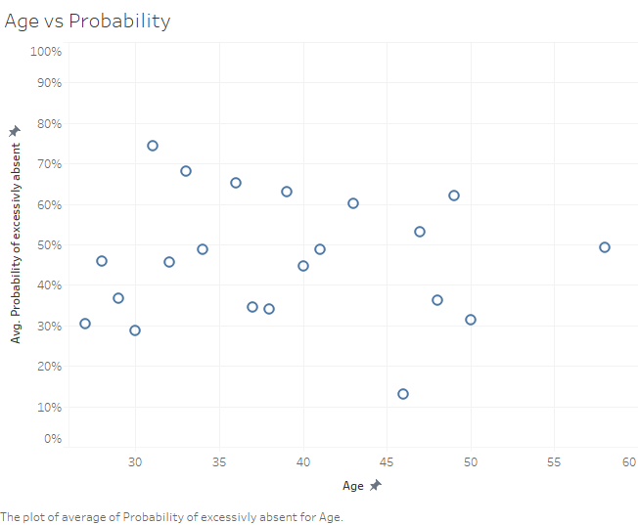
Age is not so important to predict excessively in Absent, but we can notice that people under 30 are less likely to be excessively absent from work than people above 30.

Slide 3
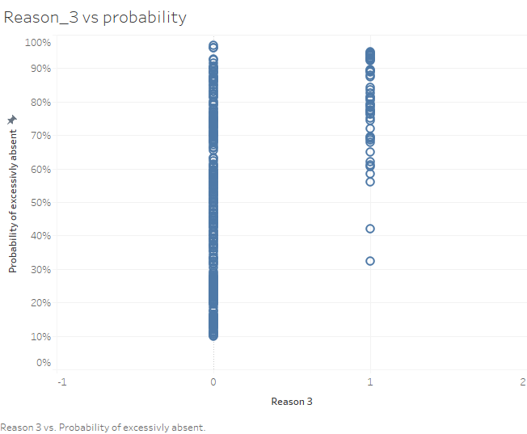
We can clearly see that when a person is absent for the Reason 3 which is related with poisoning, absolutely he will excessively absent(be absent for more than 3 hours).
This is logically true, because poisoning clearly affects a person’s health, making the person unable to work for long hours, and thus he will excessively being absent.

Slide 4
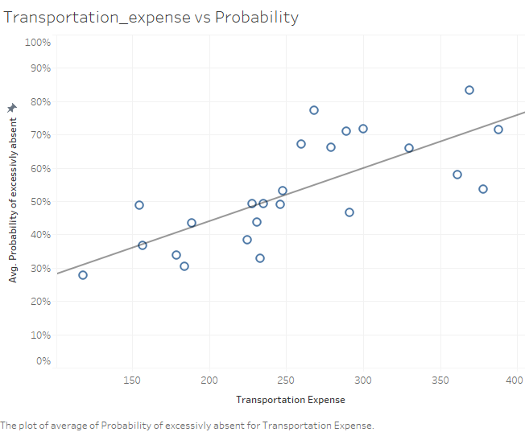
We can clearly see the relation here, The more the transportation expense is, the higher the probability of being excessively absent.
This is logically true, because peoples with high transportation expense are the one's who live far away from their work place.

